Slide 1
吸納新顧客
Acquiring new customers

Slide 2
顧客回購率和終身價值
Customer Retention and Lifetime Value
利用大數據找出你顧客的需要。
Using Big Data to find out what your customers want.
推介產品
Recommend products
測試與目標
Test and Target
為每位顧客提供獨一無二的網路購物體驗
Personalize each customer’s shopping experience.
Re-Target to Customers who have not purchased in a certain time frame

Slide 3
即將在
HK.SHOP.COM推出
Coming Soon
To HK.SHOP.COM

Slide 4
個人化體驗 Personalization
為每位顧客提供獨一無二的網路購物體驗
Delivering online shopping experiences as unique as your customers
購買健康產品的顧客首頁
Home page for Health shopper
購買電子產品的顧客首頁
Home page for Electronics shopper

Slide 5
個人化體驗 Personalization
為每位顧客提供獨一無二的網路購物體驗
Delivering online shopping experiences as unique as your customers
新顧客
New Customer
現有顧客
Returning Customer

Slide 6
這才是真正的一對一網絡行銷﹗
This is true Digital One To One Marketing!

Slide 7
這些個人化的嶄新體驗等於更多的重複
銷售，等於你更多的收入！
All this personalization means more repeat
sales which means more money for you!

Slide 8
HK.SHOP.COM強大的顧客評價功能
Powerful customer reviews on HK.SHOP.COM

Slide 9
為什麼顧客評價，在決定消費者購物上如此重要。
Why are customer reviews so important to consumer decisions to purchase.

Slide 10
63%
搜尋最新、獨特的內容 - 搜尋引擎會定期更新獨特的內容，而用戶評價就是一個很好的方法來吸引更多的內容。
Fresh, unique content for search engines - Search engines like unique content that is regularly updated, and user reviews are a great way to attract more content.
63%的顧客會在有用戶評價的網站購物
63% of customers are more likely to make a purchase from a site which has user reviews
顧客評價比產品說明更令人信服(高近12倍)
Customer reviews are significantly more trusted (nearly 12 times more) than product descriptions

Slide 11
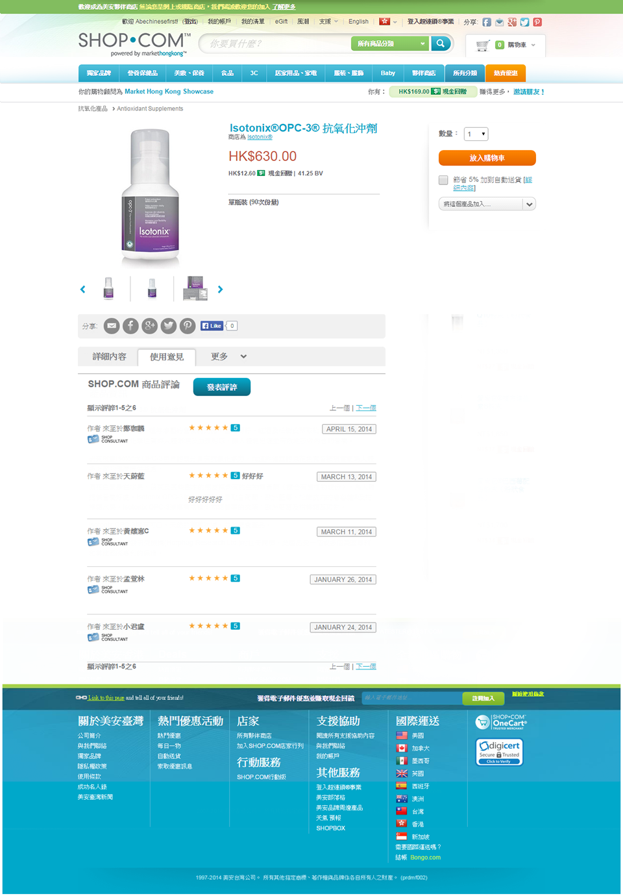
Place holder for power reviews

Slide 12
顧客獎勵
Customer Incentive
Initiatives
EZ-註冊用戶
沒有購物的正式註冊客戶
EZ-Registered Customers
Fully Registered Customers who have never purchased

Slide 13
我們免費給你$5現金回贈讓你選擇顧客
We are giving up to $5 cashback FREE, to select customers
而你無需成本﹗
At no cost to you!

Slide 14
折扣優惠
% off discount
最低訂購折扣優惠
% off minimum order
現金回贈獎勵
Cashback Incentives
生日折扣優惠
Discount on birthdays
全由SHOP.COM支付
This Is All Funded by SHOP.COM

Slide 15
一個專為你而設的優惠券計劃
A coupon program designed just for you!

Slide 16
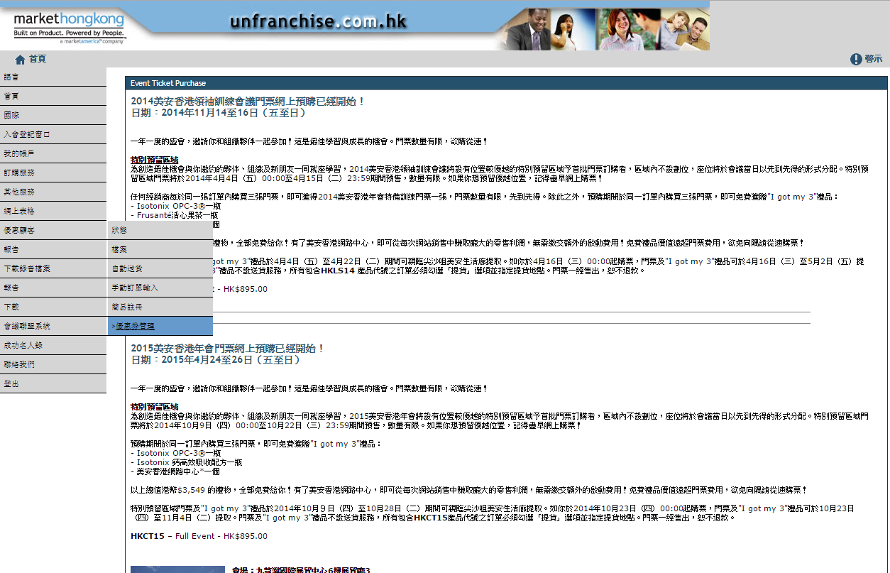

Slide 17
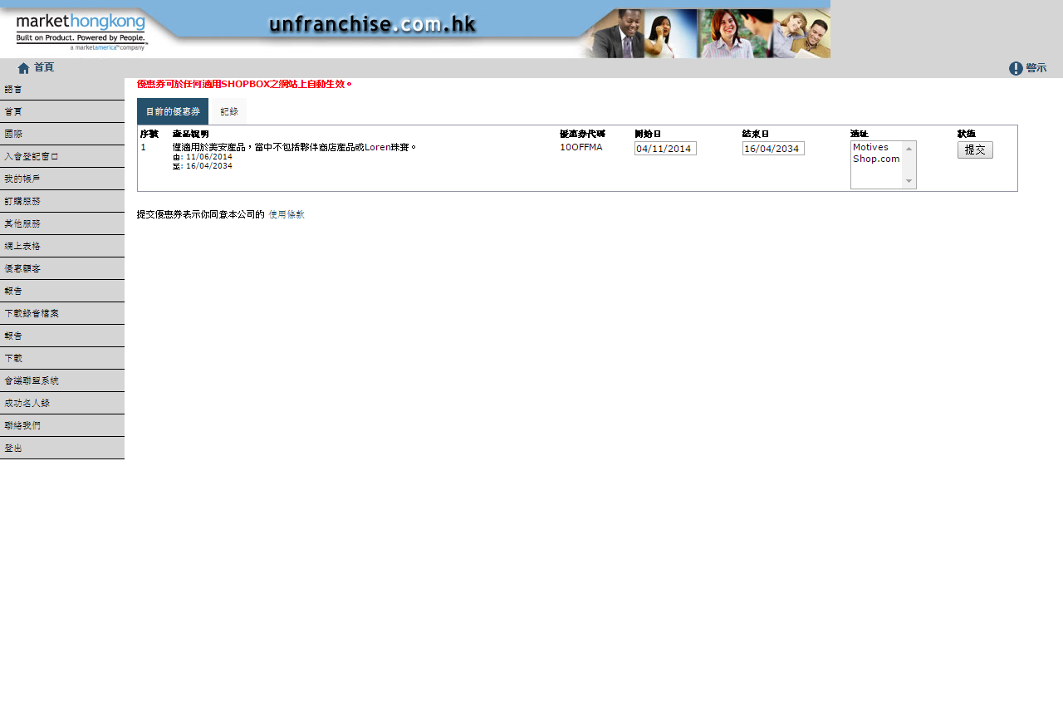

Slide 18
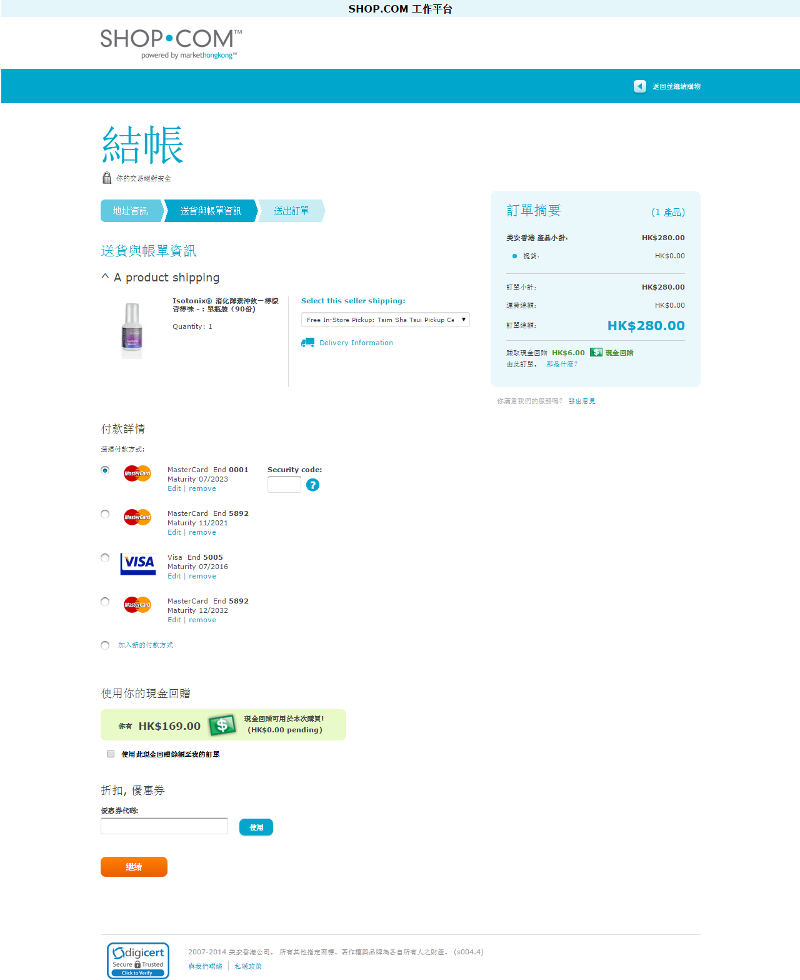

Slide 19
一個全新的強大工具，助你獲得新顧客︰
A powerful new tool to help you acquire new customers:
隆重介紹嶄新的
自定迷你網站！
Now introducing the new
Custom Mini Websites!

Slide 20
Custom Mini-Websites
滿足不同需要
Filling a Need
許多品牌或產品有不同要求
各個超連鎖店主均有不同的專注領域
開始與新顧客交談
Many requests from the field for brand or product specific sites
Different UnFranchise Owners specialize in different areas
Starting a conversation with new customers

Slide 21
Custom Mini-Websites
透過自定迷你網站，可以︰
有與產品具體對話來吸引新顧客
建立屬於自己的網站，就像MotivesCosmetics.com
引進一系列針對性的產品並以此作基礎，以隨時間擴大顧客份額
With Custom Mini-Websites you can:
Have product specific conversations to attract new customers
Create your own customized site with the power of sites like MotivesCosmetics.com
Introduce a focused set of products and use as a foundation to expand customer share over time

Slide 22
A new take on a product we’ve had for years
美觀的設計
Beautiful designs
你可以自定 You customize
產品 The products
域名 The domain
登陸頁面 The landing page
建立一個擁有無限商機的自定網站
Building out a customized niche shopping site

Slide 23
General Layout Designs
一般
設計
General Layout
Designs

Slide 24
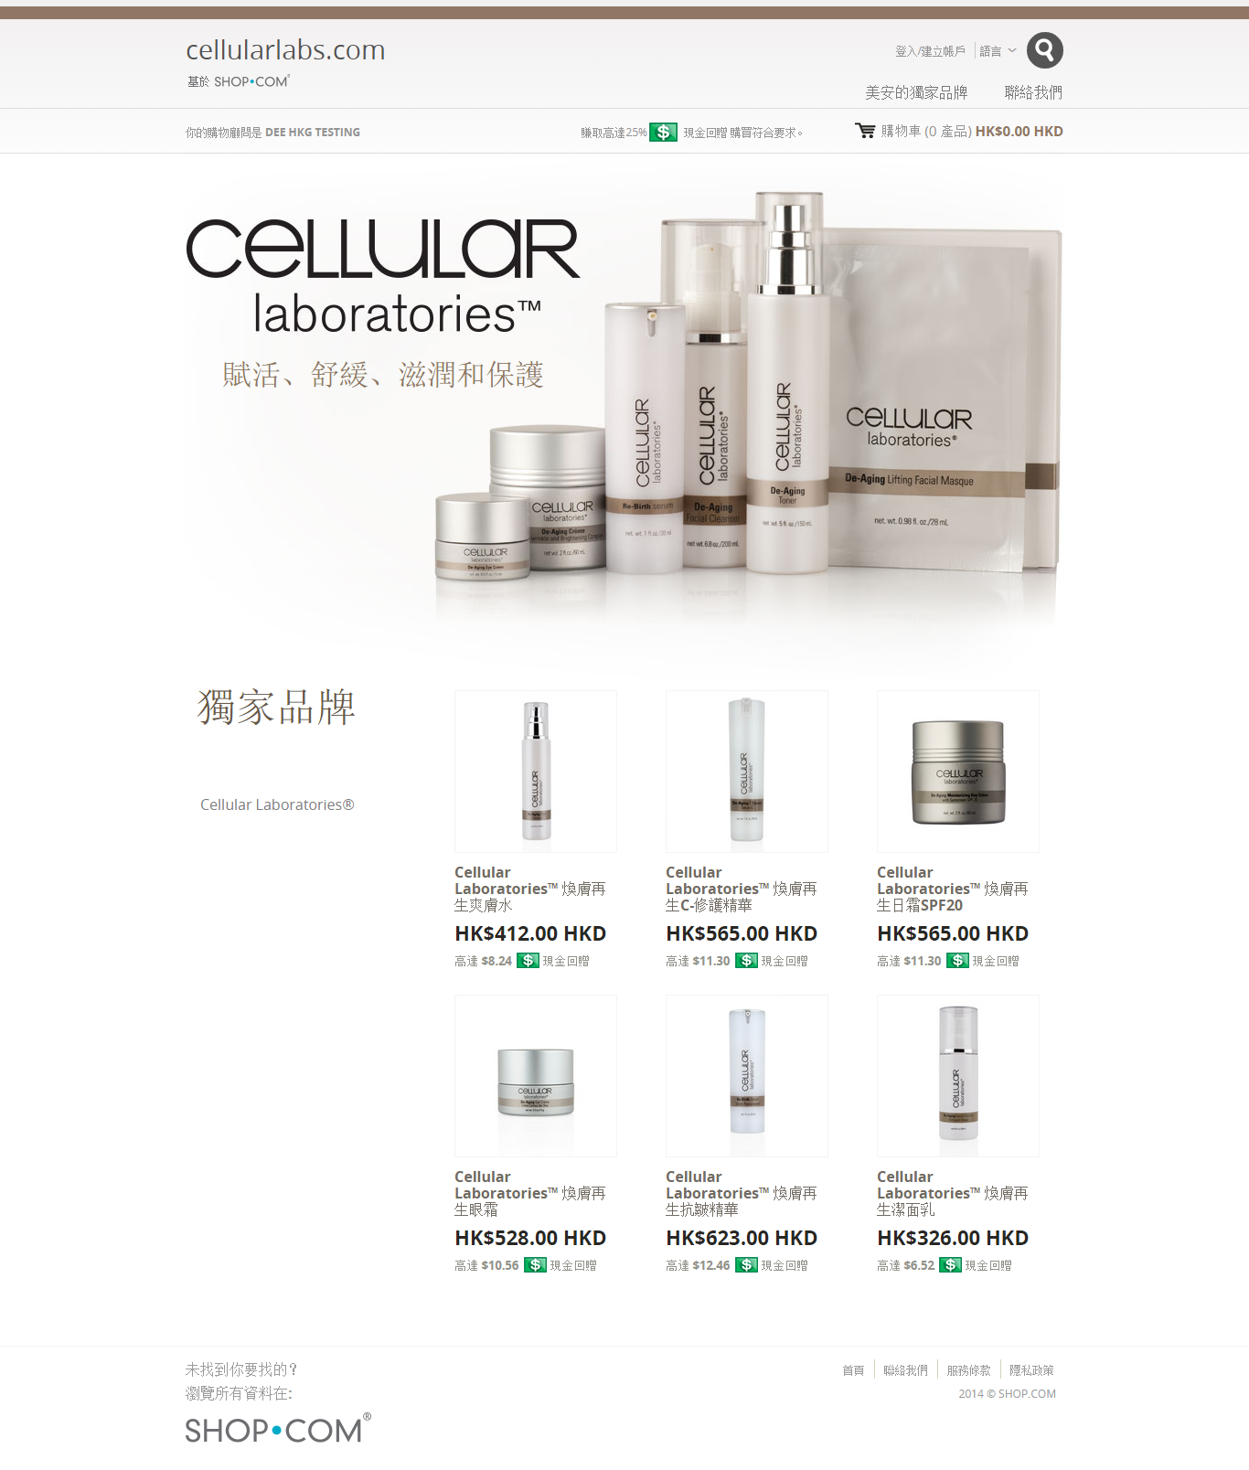

Slide 25
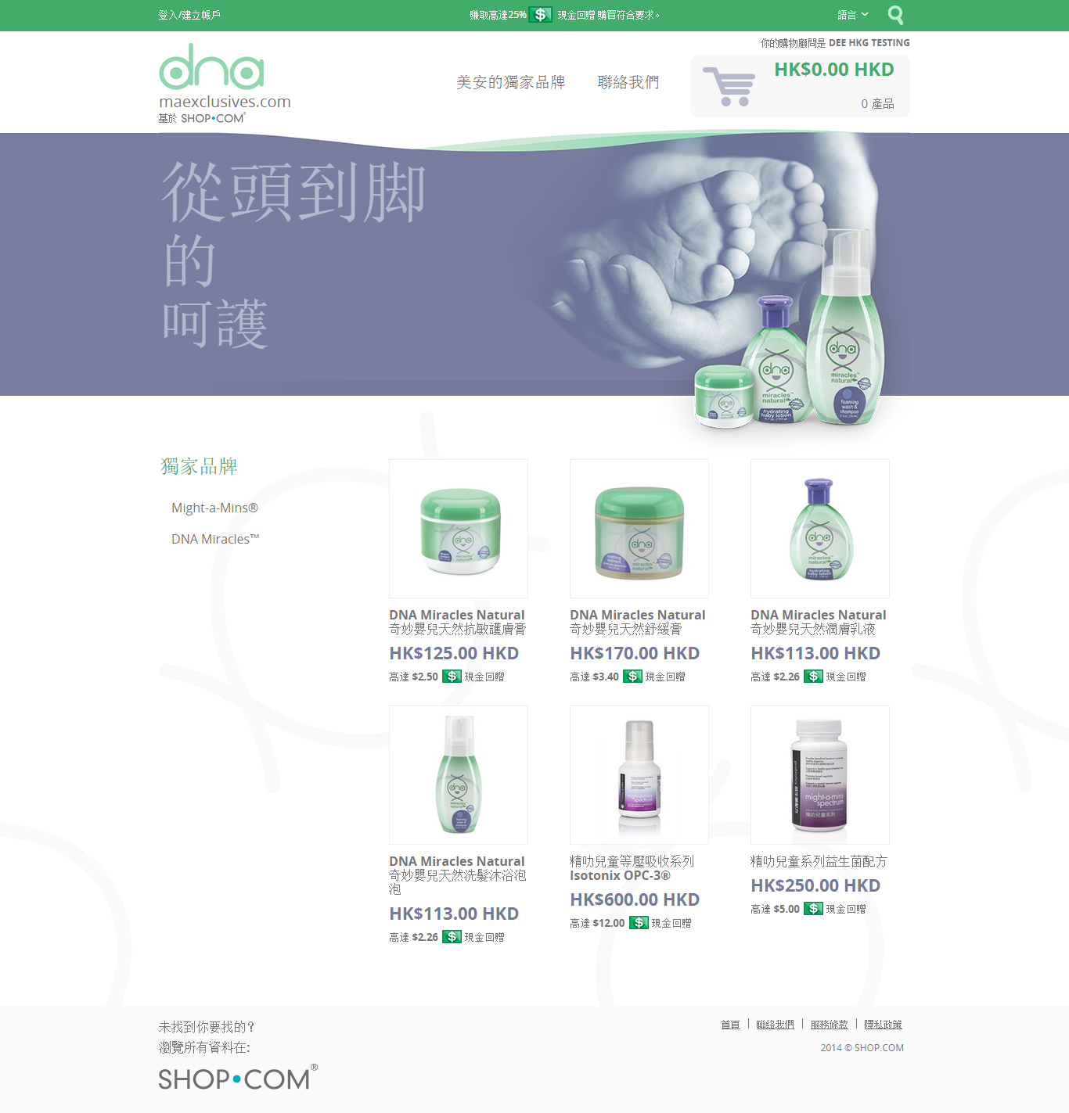

Slide 28
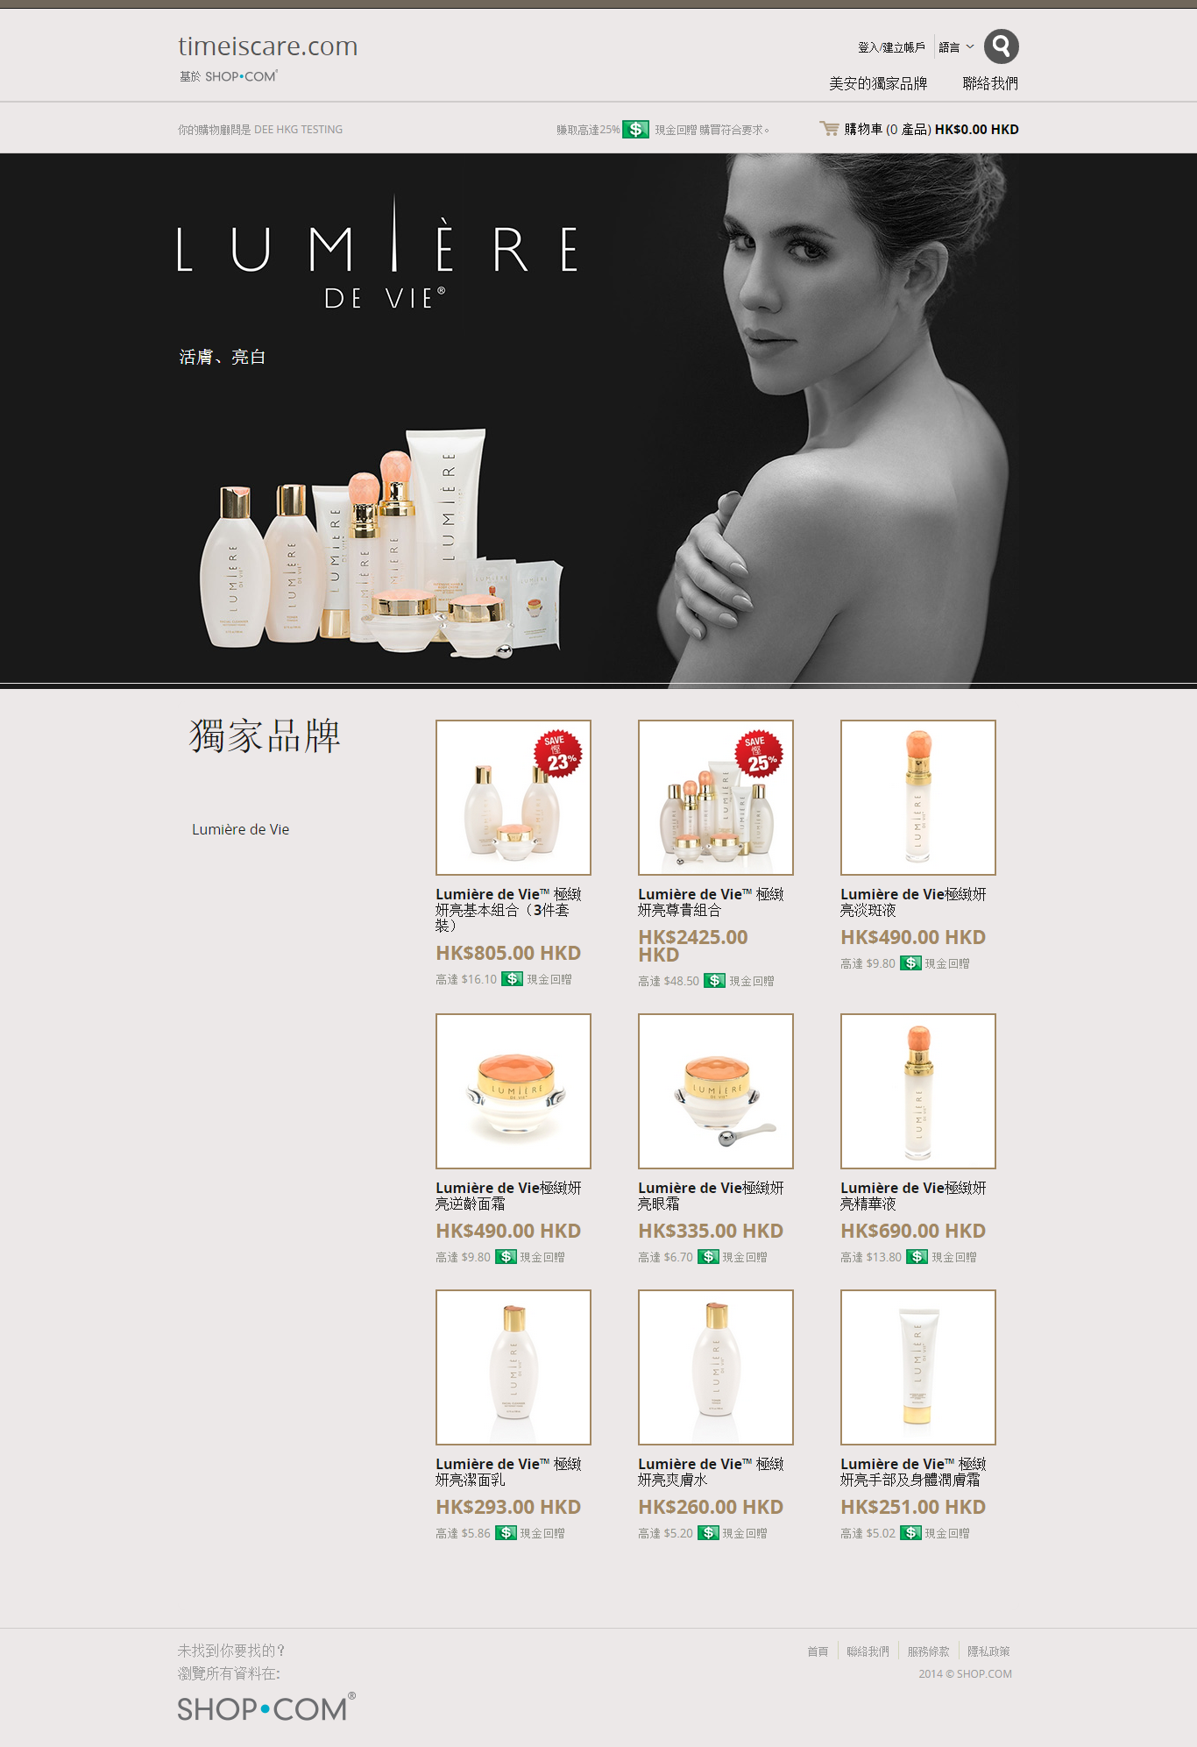

Slide 29
健康專業人士計劃 設計頁面 HP Specific Layout Designs

Slide 31
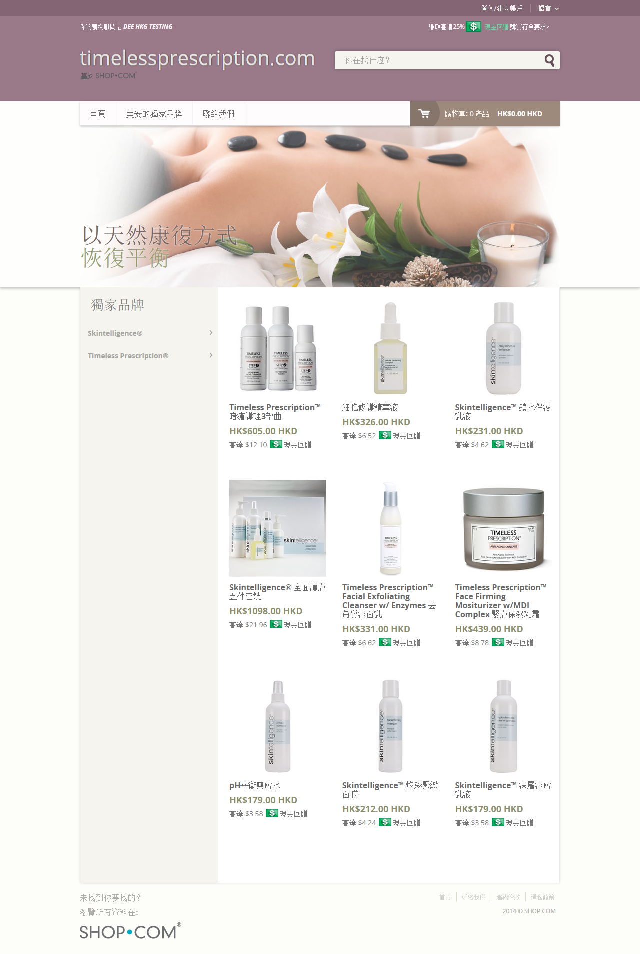

Slide 32
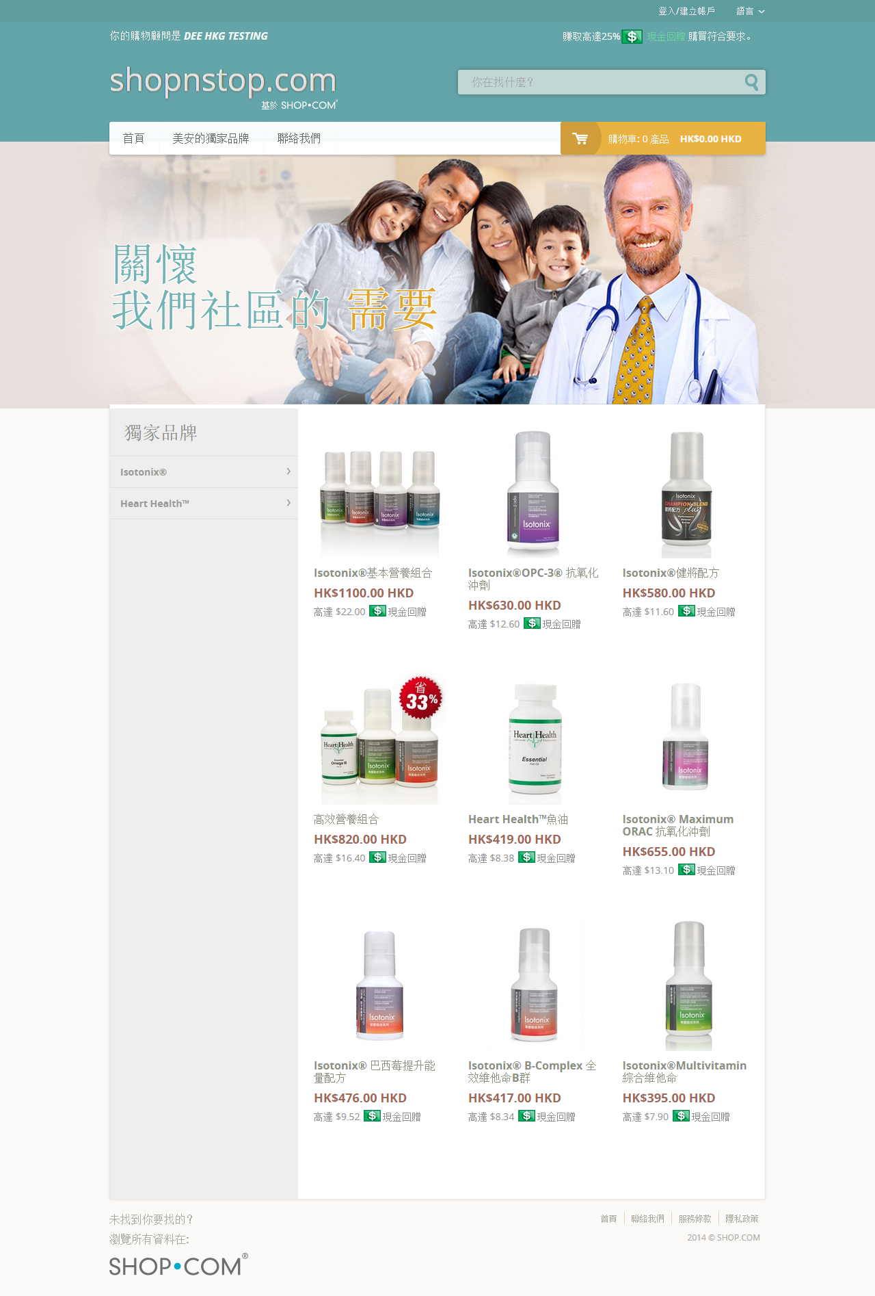

Slide 33
這就是自定迷你網站﹗
That’s exactly what the Custom Mini-websites are!
開啟電子商務大門
E-commerce enabled
更專業
Highly professional
開創商機
Niche focused

Slide 34
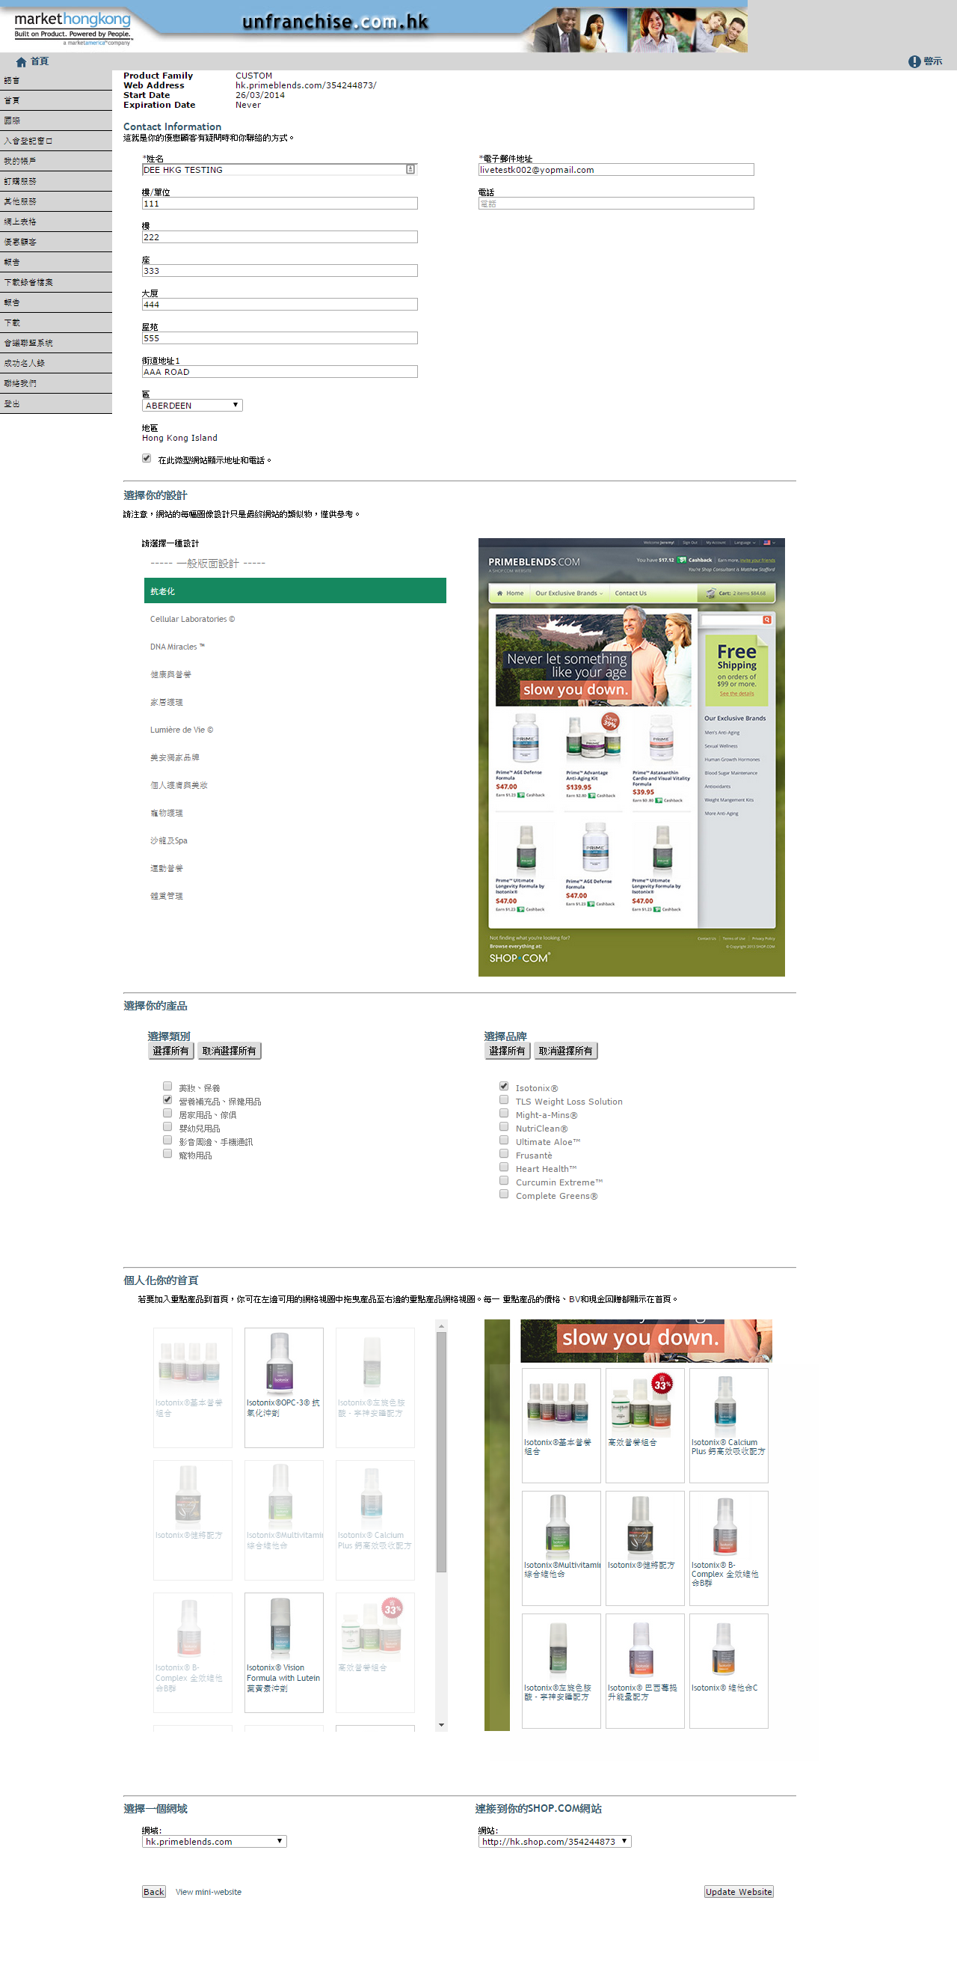
Custom Mini-Websites
每個選項獨立設置
Each subscription is set up separately
選擇主頁內容
Select what goes on the homepage
選擇設計
Select the design
選擇產品
Select the products

Slide 35
下一步是甚麼﹖
做運動時、談話時、
和人接觸時
At the gym, in conversations,
out socially
用你的網站吸納更多新顧客
Use your site to get new customers
社交媒體、網絡
Social media, online
建立他們的購物年金
Build their Shopping Annuity
這些就是下一步
Make this the follow up to
“What’s that?”

Slide 36
解決方案
The Solution
自定迷你網站就是你要的東西﹗
開啟電子商務大門
更專業
開創商機
That’s exactly what the Custom Mini-websites are!
E-commerce enabled
Highly professional
Niche focused
收費
是多少﹖
How Much Does It Cost?

Slide 37
建立網站
Setup
例如一個台灣的超連鎖店主
可以獲得
For example TWN UnFranchise Owner would get
每個國家/地區均有專屬網站Each site is specific to a country
你可以在你所屬地區的每個市場國家/地區免費獲得一個網站
You get one per market country in your region for free!
你可以買更多
You can purchase more
香港版︰ code HK6066
台灣版︰ code T6066
澳洲版︰code 76066
HKG version, code HK6066 TWN version, code T6066
AUS version, code 76066

Slide 38
哪些國家提供自定迷你網站？
So which countries are the
Custom Mini Websites in?

Slide 39
以下國家/地區已推出自定迷你網站
Custom Mini Websites Are Available IN

Slide 40
全球擴展你的顧客群
Expanding your customer base globally

Slide 42
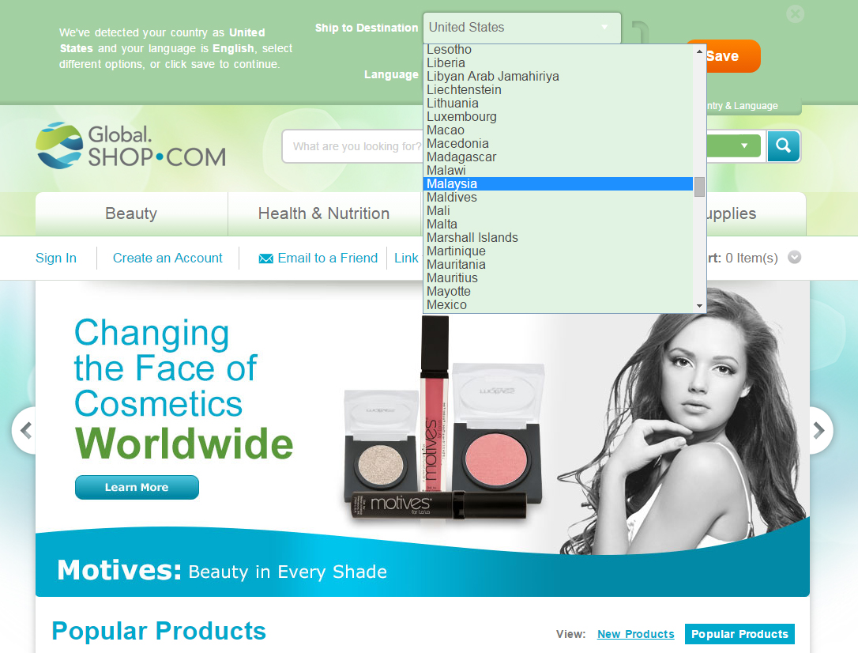

Slide 44
我們的產品已經可以運到
We are already shipping to

Slide 45
巴西
Brazil
柬埔寨
Cambodia
尼日利亞
Nigeria
牙買加
Jamaica
馬來西亞
Malaysia
菲律賓
Philippines
紐西蘭
New Zealand
韓國
South Korea
日本
Japan
澳門
Macau

Slide 46
印尼
Indonesia
新加坡
Singapore
泰國
Thailand
哥倫比亞
Columbia
俄羅斯
Russia

Slide 47
http://global.shop.com/marc
Global
SHOP.COM
的好處
Benefits of Global SHOP.COM
It’s費用
全免
Free
所有超連鎖店主將得到屬於個人的Global.SHOP.COM/xxxxx 網址
All UnFranchise Owners get their very own Global.SHOP.COM/xxxxx address
Globalshop.com

Slide 48
熱切期待
Wait for
it

Slide 49
中國
CHINA

Slide 50
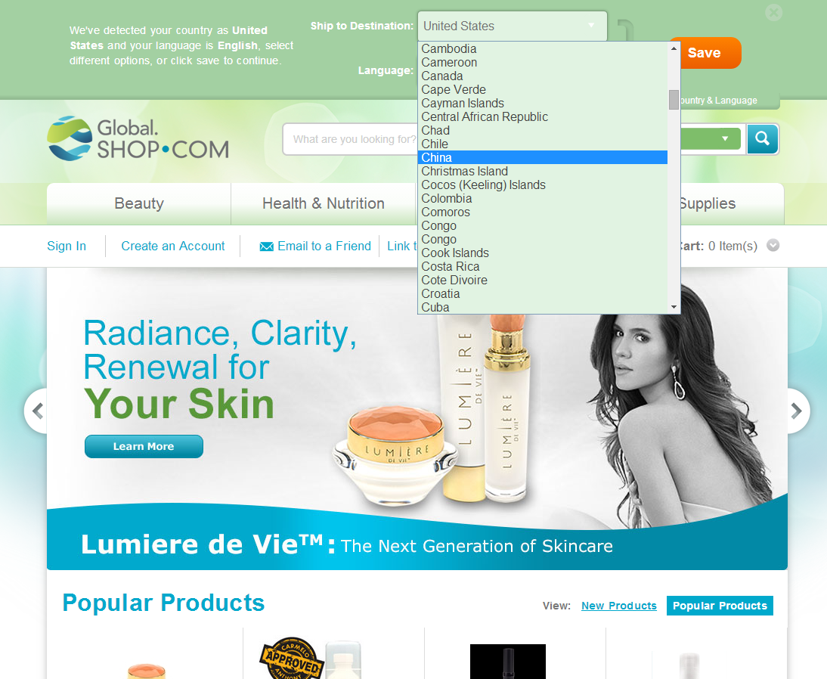
Screen shot of global with China in the dropdown menu for countries

Slide 51
Global SHOP.COM為中國顧客
提供簡體中文介面
Global SHOP.COM is in Simplified Chinese for China!

Slide 52
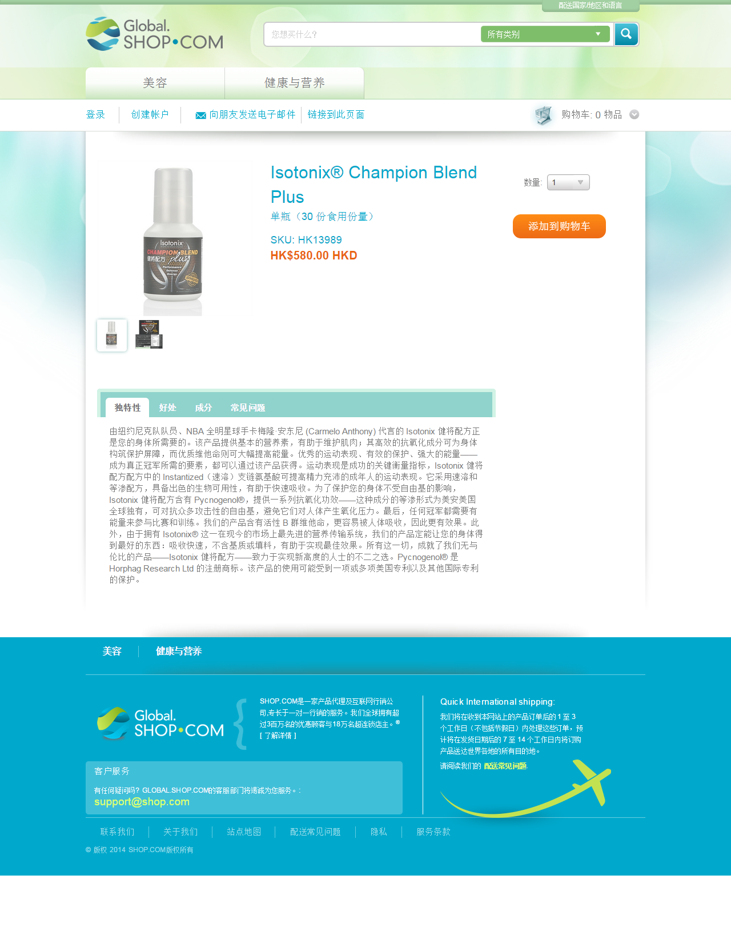
與其他國家/地區一樣操作使用﹗
Same ease of shopping as all other countries!

Slide 53
為了快速發貨，產品將直接從香港送出！
Product will be shipped from Hong Kong for faster delivery!
訂單超過HK$450
免運費
FREE SHIPPING
over HK$450

Slide 54
我們已經推出 We have launched

Slide 55
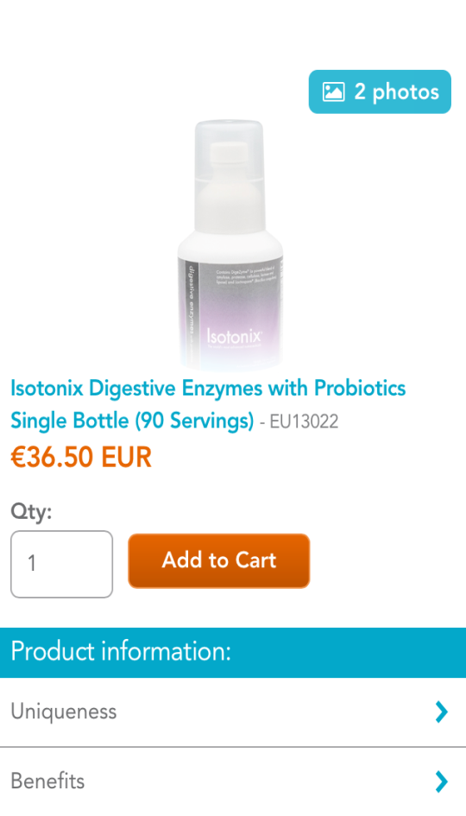
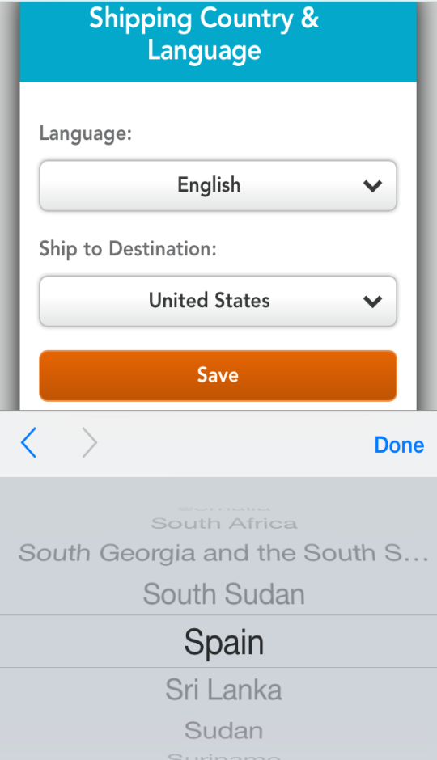
GLOBAL
SHOP

Slide 56
不單止擴展顧客基礎 Not Just for Expansion of Customer Base
全球網站Global.SHOP.COM不單擴展你於其他國家的顧客基礎，還有助公司開拓其他市場
Global.SHOP.COM not only will grow your customer base in other countries but it will help the company emerge in other markets.
Global.SHOP.COM是通往我們新興市場計劃的大門。
Global.SHOP.COM is the doorway to our new Emerging Markets Program.

Slide 57
新興市場計劃 Emerging Markets Program
新興市場計劃(EMP)提供一個簡單而有效率進程來極速投入新巿場
The EMP provides the company a simple, streamlined process for opening new markets with a very quick time-to-market for those countries

Slide 58
現有市場
Current Markets

Slide 59
新興市場計劃國家
EMP Markets
多明尼加
共和國
Dominican
Republic
厄瓜多爾
Ecuador
哥倫比亞
Colombia

Slide 60
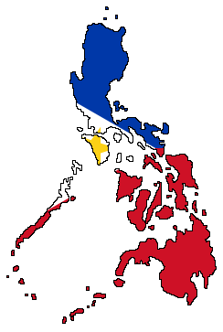
新的新興市場計劃國家
New EMP’s
巴拿馬
Panama
巴哈馬
Bahamas
牙買加
Jamaica
紐西蘭
New Zealand

Slide 61
新的新興市場計劃國家
New EMP’s
西班牙
Spain

Slide 62
我們的業務版圖不斷擴展
We Are Expanding

Slide 63
數以百計的人參與會議聯盟系統，使作為新興市場計劃的新加坡穩步發展
Singapore as an EMP is growing already with hundreds of people in the NMTSS

Slide 65
熱切期待
Wait for
it

Slide 67
Singapore
現已開業
Now
Open

Slide 68
隨著全球市場不斷發展，你需要一個能 管理你全球事業的方法。 WITH THE GROWTH OF our Global markets, You will need a way to manage your business globally

Slide 69
嶄新的超連鎖行動網站﹗
NEW UnFranchise
Mobile!

Slide 70
隨時隨地利用事業工具經營你的事業﹗
All the tools to run your business from anywhere!
銷售量
歸零警告
年度續約
合格
Sales Volume
Purge Warning
Annual Renewals
Qualification

Slide 71
完整產品分類。更有快速訂單輸入！
Complete Categorization of Products. Plus, Quick Order Entry!

Slide 72
只需輕觸手機就可快速訂購任何產品！
Quickly order any products just from the touch of your phone!

Slide 73
從任何地點提交表格1000！
快捷、操作簡單方便！
Submit your Form 1000 from any location!
Fast, Easy and Simple!

Slide 74
輕鬆添加超連鎖行動網站到你的主屏幕！
Easily add UnFranchise Mobile to your Home Screen!

Slide 75
全新快速訂購輸入
NEW
Quick Order
Entry

Slide 76
全新登記入會窗口
NEW
Signup
Wizard

Slide 77
全新邀請現在加入﹗
只需輸入他們的姓名和電子郵件，或選擇現有的PC。
New
Invite to
Join Now!
Just enter their name and email or choose an existing PC.

Slide 78
這會把他們帶到建立你的超連鎖事業介面，並開始註冊。
This will take them to Join Now and begin the signup process.

Slide 79
註冊後，
新UFO將進入
等待放置介面。
你只需透過手機把新UFO放置進你的團隊中。
NEW
After signing up, the new UFO will go into the
Waiting Room.
Place all new UFOs from Join Now with the ease of your phone.

Slide 80
我們正在增強超連鎖帳戶網站功能
We are Enhancing UnFranchise

Slide 81
從這裏開始﹗
Going from this!

Slide 82
Universal UnFranchise
更快速簡便地轉換所屬國家/地區！
Quick and easy way to change countries!
Mark, I’ve tossed in the graphics for this page, the first graphic is what it looks like before the flag is clicked, the second shows the top slide down and display a selection. Make sure to crop out the Style guide stuff so it doesn’t show on final.
This is the direct URL to these: http://labs.shop.com/projects/unfranchise-reboot/styleguide.html#
Make sure to delete this content in the final presentation as well ☺

Slide 83
Universal UnFranchise
更快速簡便地轉換所屬國家/地區！
Quick and easy way to change countries!
Mark, I’ve tossed in the graphics for this page, the first graphic is what it looks like before the flag is clicked, the second shows the top slide down and display a selection. Make sure to crop out the Style guide stuff so it doesn’t show on final.
This is the direct URL to these: http://labs.shop.com/projects/unfranchise-reboot/styleguide.html#
Make sure to delete this content in the final presentation as well ☺

Slide 84
提供所有與你事業有關的國家/地區提示。
Alerts will show for all regions and countries you are open for business in.

Slide 85
提供所有國家/地區活動資訊
Access Event Information for every country

Slide 86
窗口小工具可以顯示不同的國家和地區的資訊（例如銷售額）
Widgets can be configured to show information for different countries and regions (sales volume, etc)

Slide 87
窗口小工具可以顯示不同的國家和地區的資訊
（例如銷售額）
Widgets can be configured to show information for different countries and regions (sales volume, etc)

Slide 88
超連鎖™事業邁向全球 Universal UnFranchise
只需單靠一個UnFranchise.com
就能登錄和管理所有地方業務。
Single UnFranchise.com for everyone to log into and manage all aspects of their business all in one place.
全球運送
Ability to drop ship around the world

